Slide 1
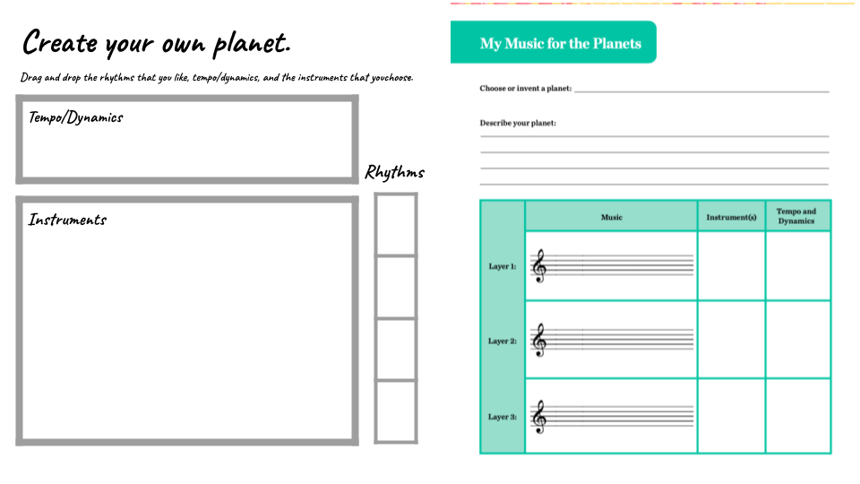
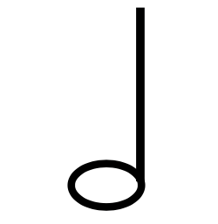
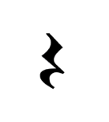
Soft
Soft
Loud
Soft
Loud
Loud
Triangle
Violin
Flute
Trumpet
Timpani
Viola
Trombone
Cello
French Horn
Xylophone
Oboe
Tuba
Clarinet

